Slide 1

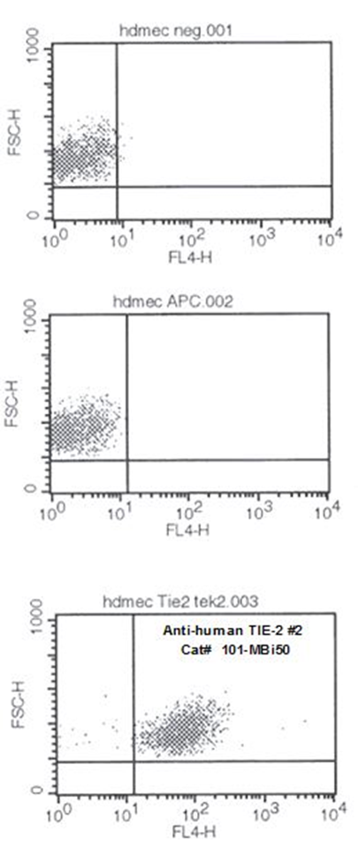
ReliaTech GmbH
Mouse anti-human TIE-2 (#tek2)
(Cat #101-MBi50)
Fig. 1: FACS analysis with primary human umbilical vein endothelial cells (HUVEC) using a Biotin-conjugated mouse anti-human TIE-2 antibody.
http://www.reliatech.de / orders@reliatech.de

